Slide 1
C Programming
Directory Listing

Slide 2

Finding out what files are in a directory
The course notes cover all kinds of methods but we're looking at Windows specifically

Slide 3

Section 24.3 ("Windows 32 bit Search Functions")
You are not responsible to know the other file search methods

Slide 4
Need to:
#include <windows.h>

Slide 5
Need to:
declare a variable of type
struct WIN32_FIND_DATA
e.g. WIN32_FIND_DATA fileData = {0};
This variable is used to keep track of the information you’ve gotten so far

Slide 6
If you don't declare the variable, you can't do anything with searching for files!

Slide 7
Visual Studio Important Note
You MUST change the "Character Set" in the Project Properties to Multi-Byte

Slide 8
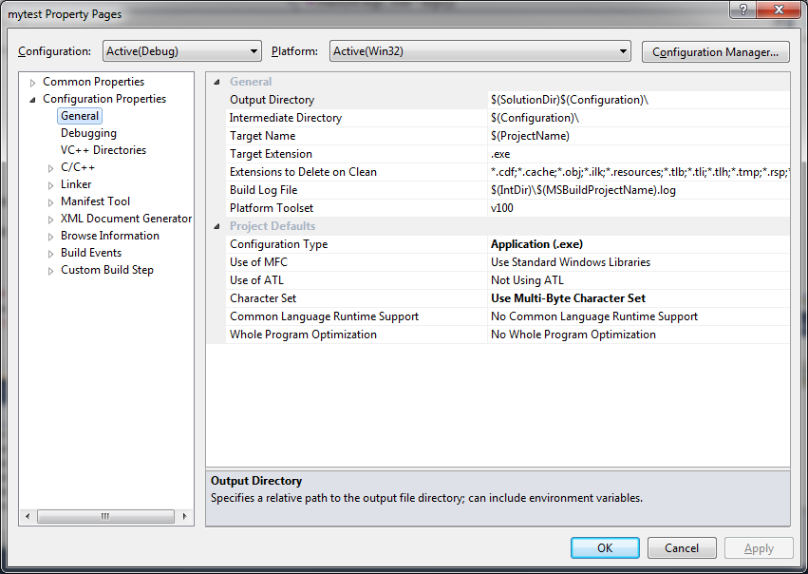

Slide 9
If you don't do that, your code will not work properly!

Slide 10
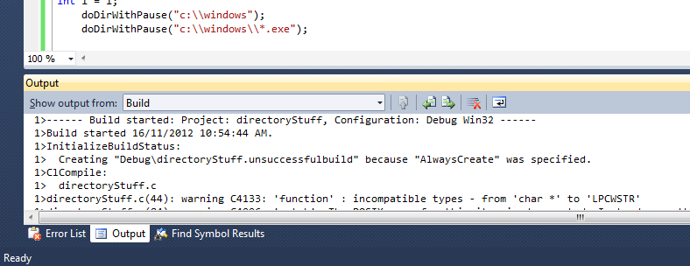

Slide 11

Ignore the warning
at your own peril!

Slide 12

FindFirstFile()
Need to call FindFirstFile() in order to find out what is the first file that it found in the directory

Slide 13
FindFirstFile() (cont.)
Prototype:
HANDLE FindFirstFile(
char *where, WIN32_FIND_DATA *pInfo)

Slide 14
First parameter is a string indicating a directory or file specification
This can contain:

Slide 15



wild cards:
* matches zero or more occurrences of any character
? matches zero or one occurrences of any character

Slide 16

Don’t forget the
double-backslashes

Slide 17
Examples of the first parameter:
“c:\\windows”
“c:\\windows\\*.*” “c:\\windows\\*.exe”
“c:\\windows\\tw*.*”
“c:\\windows\\??.*”

Slide 18
Second parameter is
the address of the variable
that you declared earlier

Slide 19


FindFirstFile() (cont.)
If FindFirstFile() returns
INVALID_HANDLE_VALUE,
it didn’t find anything

Slide 20
FindNextFile()
FindNextFile()
uses both the
handle returned from FindFirstFile()
and the WIN32_FIND_DATA variable

Slide 21
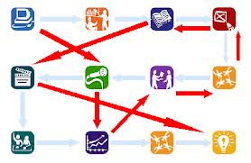
It finds more files after the first one, keeping track of what it’s found so far

Slide 22
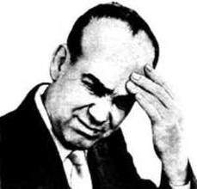
There is no easily-determinable order to the files presented

Slide 23

FindClose()
Once done, need to call FindClose(), passing the handle returned from FindFirstFile()

Slide 24
WIN32_FIND_DATA struct
typedef struct { DWORD dwFileAttributes; // 32 bits FILETIME ftCreationTime; FILETIME ftLastAccessTime; FILETIME ftLastWriteTime; DWORD nFileSizeHigh; DWORD nFileSizeLow; DWORD dwReserved0; DWORD dwReserved1; TCHAR cFileName[MAX_PATH]; // array of char TCHAR cAlternateFileName[14]; // array of char
} WIN32_FIND_DATA;

Slide 25
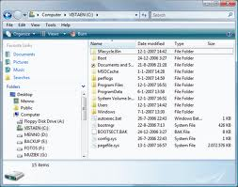
You will use the variable that you declared to get the information about the file (or directory)

Slide 26

You want to pay attention to the following example!

Slide 27
But you need to know about
Bitwise-AND
&

Slide 28
Value 1 (binary) | Value 2 (binary) | Value 1 & Value 2
1001 | 1000 | 1000
1100 | 1001 | 1000
0101 | 1010 | 0000
0101 | 1011 | 0001
0000 | anything | 0000
1111 | xxxx (any value) | xxxx
11100111 | 00100000 | 00100000
Binary Values

Slide 29
Example
void doDir(char *where)
{
WIN32_FIND_DATA filedata = {0};
HANDLE h = FindFirstFile(where, &filedata);
if( h != INVALID_HANDLE_VALUE )
{
do
{
printf("Name is %s\n", filedata.cFileName);
if((filedata.dwFileAttributes
& FILE_ATTRIBUTE_DIRECTORY) != 0) printf("\tIt is a directory\n");
else
{
printf("\tIt is a file\n");
printf("\tSize is %d\n", filedata.nFileSizeLow);
}
} while( FindNextFile(h, &filedata) );
FindClose(h);
}
}

Slide 30
REMEMBER!
Visual C++ 2010 will produce a bug in your program unless you make a change to the project properties to "Use Multi-byte Character Set" instead of using Unicode.
You must change this from the default in order to get your program to work!
You will need to remember this for next semester!

Slide 31
PowerPoint Slide Note
Many of the following slides will talk about the fields of the WIN32_FIND_DATA struct.
When you actually use them, you will use them with the variable that you declare!

Slide 32
File Names
The normal long filename is found in the null-terminated string contained in cFileName.

Slide 33
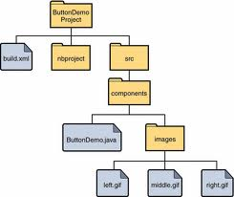


dwFileAttributes
Some of the more important file attributes:
If FILE_ATTRIBUTE_DIRECTORY is set, the handle identifies a directory.
If FILE_ATTRIBUTE_HIDDEN is set, the file or directory is hidden. It is not included in an ordinary directory listing.
If FILE_ATTRIBUTE_READONLY, the file or directory is read-only.

Slide 34

Finding out if an attribute is set
In order to see if an attribute is set, do a bitwise-AND with the attribute field of the WIN32_FIND_DATA variable
e.g. if( (filedata.dwFileAttributes & FILE_ATTRIBUTE_DIRECTORY) != 0 )

Slide 35
File Sizes
The file size is stored in the nFileSizeHigh and nFileSizeLow fields of the struct.

Slide 36
If the size of the file is less than MAXDWORD bytes (0xFFFFFFFF = over 4 billion), then nFileSizeHigh is 0.

Slide 37
Otherwise, the size of the file is (nFileSizeHigh * (MAXDWORD+1)) + nFileSizeLow
This value will NOT fit in an int

Slide 38
Assignment #5 only is concerned with files that have nFileSizeHigh of 0 (for simplicity)

Slide 39
Exam Note
You are not responsible for the following information about Time attributes or functions for an exam
You should be aware of its existence for later assignments and projects, though

Slide 40
File Times
There are several times associated with the WIN32_FIND_DATA struct:
ftCreationTime
ftLastAccessTime
ftLastWriteTime
File times are stored as a FILETIME struct.

Slide 41
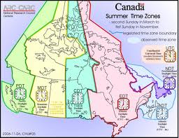
FILETIME
The FILETIME structure is a 64-bit value representing the number of 100-nanosecond intervals since January 1, 1601 (UTC).
e.g. typedef struct { DWORD dwLowDateTime; DWORD dwHighDateTime;
} FILETIME
UTC is NOT local time; it’s Greenwich Mean Time.

Slide 42

UTC or GMT
is the time currently
at the Royal Observatory
in Greenwich, London, England

Slide 43
FileTimeToSystemTime
To convert a FILETIME structure into a time that is easy to display to a user, use the FileTimeToSystemTime function

Slide 44
Prototype: BOOL FileTimeToSystemTime( const FILETIME* lpFileTime, SYSTEMTIME *lpSystemTime );
This converts a FILETIME to a SYSTEMTIME

Slide 45
Returns nonzero if succeeds
or
zero if fails

Slide 46
SYSTEMTIME
The SYSTEMTIME structure represents a date and time using individual members for the month, day, year, weekday, hour, minute, second, and millisecond.
typedef struct _SYSTEMTIME { WORD wYear; WORD wMonth; WORD wDayOfWeek; WORD wDay; WORD wHour; WORD wMinute; WORD wSecond; WORD wMilliseconds;
} SYSTEMTIME, *PSYSTEMTIME;

Slide 47
SYSTEMTIME fields
For wMonth, January is 1.
For wDayOfWeek, Sunday is 0.
wDay is the day of the month, starting at 0 for some strange reason and going up to 31.
wHour is 0 to 23.

Slide 48
Converting to Local Time
Even with all this, the time is still in UTC (Greenwich Mean Time).
Use SystemTimeToTzSpecificLocalTime()
Sample call: SystemTimeToTzSpecificLocalTime(NULL, &stUTC, &stLocal);
The first parameter is lpTimeZone and can be NULL if you want to use the time zone that you set up in Windows. Otherwise, it has to be a pointer to a TIME_ZONE_INFORMATION structure that specifies the time zone of interest.
The other two parameters are pointers to SystemTime structs.

